Slide 1
Accessibility in the Virtual/Augmented Reality Space
Beth Crutchfield, Vice President, Strategic Consulting and Training Services
Jessie Haugh, Accessibility Specialist
CSUN 2018 Assistive Technology Conference
March 22, 2018

Slide 2
Agenda
Definition of VR and AR
Benefits of VR and AR in the Disability Community
Creating an Accessible VR/AR Experience
Legal Landscape
Policy and Program Recommendations
Q&A

Slide 3
What is VR/AR?
Definitions
Virtual Reality (VR)
Computer-generated simulation of a three-dimensional image or environment that can be interacted with in a seemingly real or physical way by a person using special electronic equipment, such as a helmet with a screen inside or gloves fitted with sensors (www.vrs.org).
Example: Batman: Arkham VR
Augmented Reality (AR)
Technology that superimposes a computer-generated image on a user's view of the real world, thus providing a composite view (Introducing Virtual Environments National Center for Supercomputing Applications, University of Illinois).
Example: Pokémon GO

Slide 4
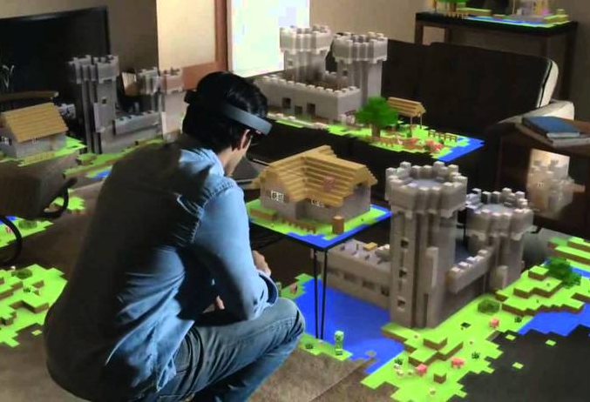
Benefits of VR/AR
Why should we invest?
Hospitality
Search new areas before visiting
Healthcare
Improved patient understanding
Rehabilitation
Video Games
New dimension to interactive gaming
Education/Overall Training
Immersive learning experience
Applicable to military, medical, education, etc.
Research

Slide 5
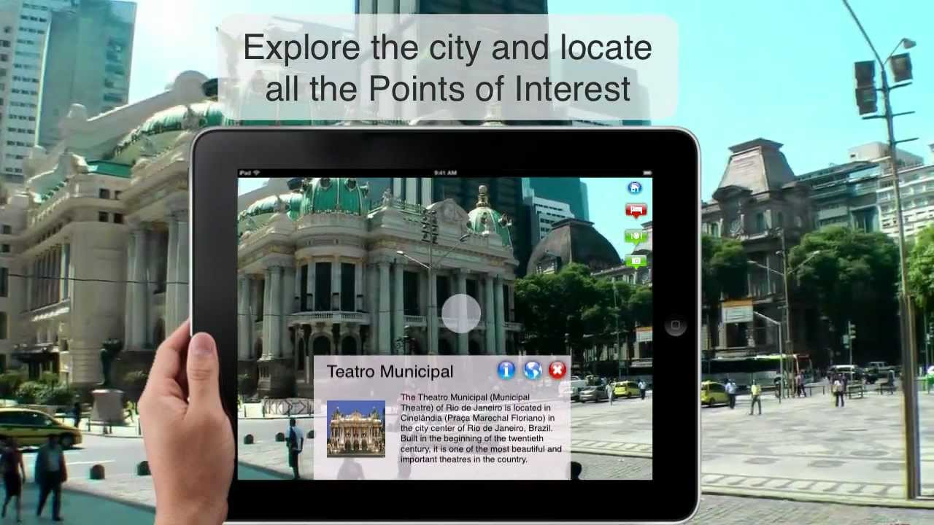
Hospitality
Why should we invest?
Visit their location before booking
Coordination – plan all activities and know locations before arrival
Interactive Site Map
AR Tour Guide Experience
Emergency Situations
Figure 1: Travel to Rio – Tourist Guide with Augmented Reality
Notes:
Visit their location before booking – allows users who have physical disabilities to view the environment and determine their best path to navigating your site and viewing the landscape
Coordination – plan all activities and know locations before arrival – beneficial for all end user groups with disabilities
Interactive Site Map – assist end users who are blind in identifying paths throughout your site,
AR Tour Guide Experience

Slide 6
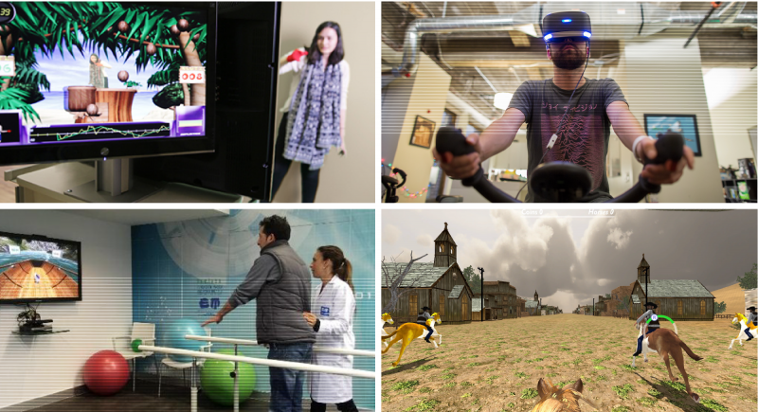
Healthcare
Why should we invest?
Improvement in patient understanding of medical diagnosis and past records
Pain Management
Treating Mental Illness
Exercise & Physical Therapy
Figure 2: Worrel
Notes:
Expand the number of end users – applicable to all disability groups

Slide 7
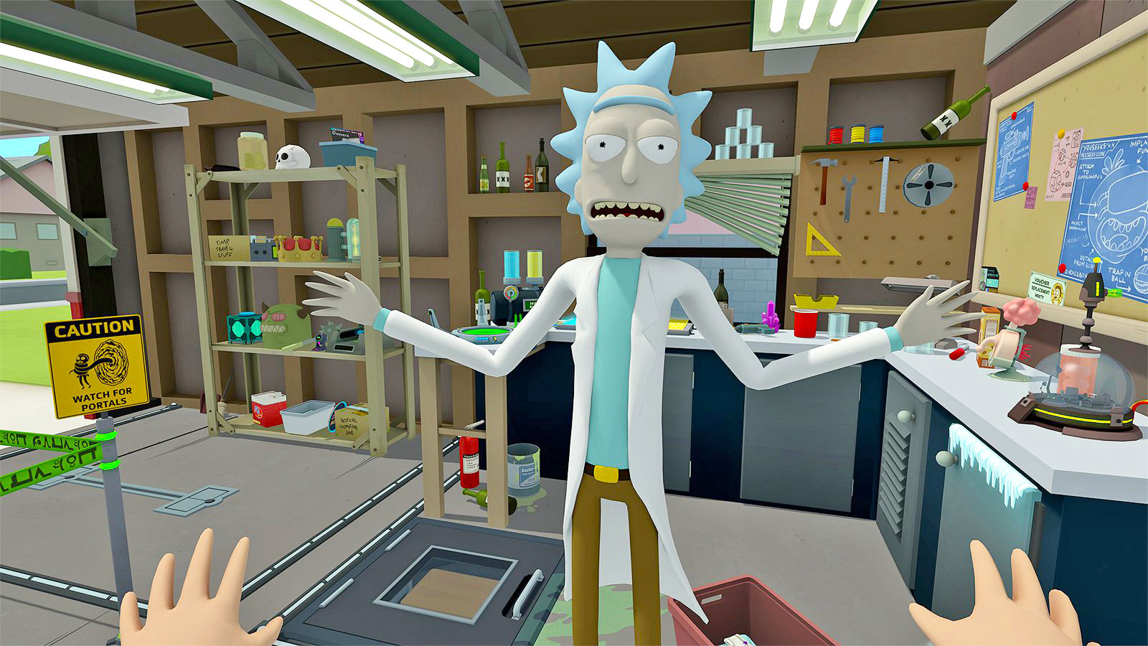
Video Games
Why should we invest?
New dimension to interactive gaming
Pain management
Social Isolation Improvement
Need for Play
Figure 3: Rick and Morty Virtual Rick-ality Game
Notes:
I have pain management referenced twice, as research has found that, when an individual is focused on an interactive objective that requires their attention in a fun manner, they are more likely to experience less pain. By experiencing less pain, I mean that, because they are essentially distracted, it is not as big of an issue during that time frame. Allowing even just an hour of distraction can positively impact an individual emotionally, mentally, and physically.
Gaming provides social inclusion, where multiple people work together in a team environment to complete a specific objective and/or task. It breaks down the social isolation barrier by having everyone focused on the game, rather than on the person’s disability. Furthermore, gaming is the world’s largest pastime.
This spreads across all disability groups.

Slide 8
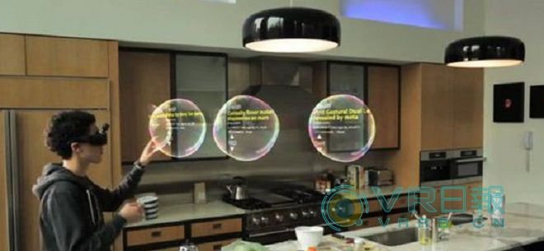
Education
Why should we invest?
Medicine
Practice minimally invasive surgeries with no risk
Emergency scenarios
Military
Real-time practice for military combat scenarios
Practice group tactical maneuvers
Flight & Battlefield simulation
Medic Training
Vehicle Simulation
Classroom
Enhanced learning of core content
Increased engagement
Figure 4: VR in the Classroom
Notes:
Medicine – applicable to all disabilities. When built with a11y in mind, can have end users practice multiple times without risk to real-life injury. Emergency situations –
Military – cognitive/learning disabilities. A new way to build and understand concepts and training mechanisms
Classroom – applicable to all disabilities.

Slide 9
Creating an Accessible VR/AR Experience
Notes:
VR and AR, if developed with accessibility in mind, will allow all consumers to interact in a truly immersive experience, and include opportunities where an individual can try/experience/compete in something new, where they could not in their every day life.
“Anyone who experiences certain barriers to physical mobility in the real world could take control of a digital avatar’s body and visit new places, play games, or take part in rehabilitative experiences in ways that are more immersive and more meaningful than those that previous digital technologies could offer.” (techradar)

Slide 10
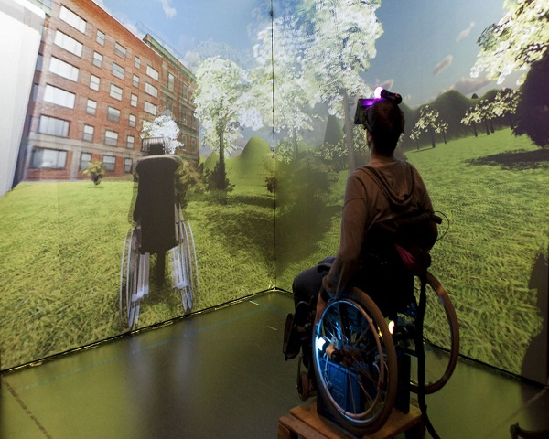
Current Barriers
What are we up against?
Heavy emphasis on motion controls
Specific requirements on positioning in the space
Strict hardware guidelines
Limited audio
Core-reliance on visual stimulus

Slide 11
Concepts: Mobility
Customizable HUDS
Allowance of third-party hardware
Allowance of minimal controller capabilities
Allowance to control avatar with controller
Customizable Movement
Motion Sickness Prevention
Sensitivity Sliders
Overall Speed Settings
Central Placement Point
Input Support
Notes:
In regards to AR – remappable ways to achieve goals. Ex: If the end user has to pick up the an item physically, allow remapping where they push a button on the controller.

Slide 12
Concepts: Visual
Changeable Text and Color Size
Colorblind Options
HD Screen with ability to:
Zoom
Focus
Contrast
Color
Environment Description
Auditory Placement and Event Stimulus Updates
Updates to avatar placement

Slide 13
Concepts: Auditory
Audio Cues
Changeable Fonts and Colors
Active Events and Ambient Noise Indicator
Both usability and accessibility recommendation
In-View Closed Captioning
Differences between Subtitles and Closed Captioning
Notes:
Active Events & Ambient Noise Indicator – this is case by case. If relatively simple, this can be achieved. However, you may achieve worst-off experience

Slide 14
Concepts: Cognitive
Tutorials
Sandbox Modes
Open world concept
Difficulty Levels
Intuitive Menus
Usability and accessibility recommendations
Perspectives
Ties with optional avatar settings
Customizable settings
Notes:
*If you don’t want to require certain accessibility measures, the best next step is to provide Settings, where these features can be activated/deactivated per the user’s request.

Slide 15
The Policy and Programs Surrounding VR/AR

Slide 16
Legal Landscape
Currently no legislation, but anticipate movement in this space in the next 5-7 years
ADA provides some governance
Numerous lawsuits and consent decrees tied to ADA Title III
We recommend proactively addressing AR and VR accessibility to avoid legal risk
Notes:
While there is currently no legislation or governing regulation tied to the VR and AR space, we anticipate movement in this space in the next 5-7 years
The Americans with Disabilities Act (ADA) does provide some governance for producers/owners of Digital assets
There have been numerous lawsuits and consent decrees tied to ADA Title III violations and we should view this as a clear indicator of where the market is heading
Many of our clients are currently proactively addressing AR and VR and we encourage you to follow suit
To ensure you are protected from legal and or regulatory exposure, we encourage you to start the following activities if you use AR or VR or plan to in the near future.

Slide 17
Accessibility Questionnaire
Step 1: Complete an Accessibility Questionnaire
Purpose:
Identify your at-risk AR and VR (and other digital assets)
Use:
Primary data collection tool for next step in the process - Systems Survey & Analysis
Notes:
Purpose:
Understand your at risk AR or VR (as well as other digital assets) and the applicable laws and regulations for same
Primary data collection tool for creating a Systems Survey & Analysis
Target questions on what the asset is, how you offer it, which user types use it, level of traffic/use, accessibility precedence, etc.
Use:
Primary data collection tool for Systems Survey & Analysis which is the recommended next step in this process

Slide 18
Systems Survey & Analysis
Step 2: Conduct a Systems Survey & Analysis
Purpose:
Outline legal coverage of AR and VR inventory (and other digital assets) and understand the associated risks
Use:
Enables you to group assets into high-, medium-, and low-risk categories for strategic planning
Notes:
Purpose:
Helps you outline legal coverage of your AR and VR inventory (as well as other digital assets) for applicable laws and regulations
Analyze all your digital assets to understand the risk associated with same
Use:
Enables you to group your digital assets into high, medium, low priority risk categories to facilitate strategic planning

Slide 19
Accessibility Policy
Step 3: Define your Digital Accessibility Policy
Purpose:
Define your digital accessibility scope, applicable laws/ standards, and establish formal governance structure
Use:
Communicate official policy internally and help safeguard against legal complaints/inquiries
Notes:
Purpose:
Define your organization’s digital accessibility scope (AR/VR and all other digital assets), applicable laws/standards and establishes formal governance structure
Also contains what exceptions there may be to your policy and why these exceptions are made
Use:
Publish internally to communicate official policy and help safeguard your organization against legal and/or regulatory complaints/inquiries

Slide 20
Accessibility Strategy
Step 4: Develop your Digital Accessibility Strategy
Purpose:
High-level, three-phase strategy for developing, rolling out and scaling up your Digital Accessibility Program over next 3-5 years
Use:
Framing document to put in place a robust accessibility program
Notes:
Purpose:
High-level strategy for developing, rolling out and scaling up your organization’s Digital Accessibility Program for your public-facing digital assets
Outlines “what” should be done over next 3-5 years… phased approach with milestones:
Phase 1: Formalizing the Accessibility Program
Phase 2: Addressing High-Priority Apps/Pilot Program
Phase 3: Full rollout and scale up
Use:
Framing document to put in place a robust accessibility program within your organization

Slide 21
Project Management Plan
Step 5: Build your Digital Accessibility Project Management Plan
Purpose:
Provide a clear roadmap for implementing the Strategy – timing, resources, budget
Use:
Assists in defining your long term organizational strategy
Notes:
Purpose:
Provides a clear roadmap for implementing the Strategy – i.e. the “when” and “how”
Provides a time-based view of the program unfolding, with budgetary plan
Outlines dated phases (timed roadmap), assumptions, high-level budget and risks to help you determine how to implement the Strategy
Assumptions for staffing, training, and platform tools
Budgets with rough amounts for staff, policy/program services, training, vendor remediation/consulting support, and tools/infrastructure
Use:
Assists your organization in defining your long term organizational strategy

Slide 22
Summary
After completing these steps, your organization will have a clear understanding of:
The overall approach to accessibility
The relative merit and priority of fixing specific systems
A policy framework for managing digital accessibility
The budget, timing, and activities for making it all happen
**Note: Level Access offers these services as part of our Access Blueprint product.

Slide 23
Questions?

Slide 24






Thank You!
Accessibility in the Virtual/Augmented Reality Space
Contact Us
Follow Us
Beth Crutchfield
Beth.Crutchfield@LevelAccess.com
@LevelAccessA11y
Level-Access
Jessie Haugh
Jessie.Haugh@LevelAccess.com
Level Access
Level Access Blog
Slide Deck Available for Download at: https://www.levelaccess.com/csun18/

